Slide 1
Machine Learning:
Supervised Learning
Nick Lutostanski
PGP AI/ML for Business Applications
2.1.24

Slide 2
Contents / Agenda
Executive Summary
Business Problem Overview and Solution Approach
EDA Results
Data Preprocessing
Model Performance Summary
Appendix

Slide 3
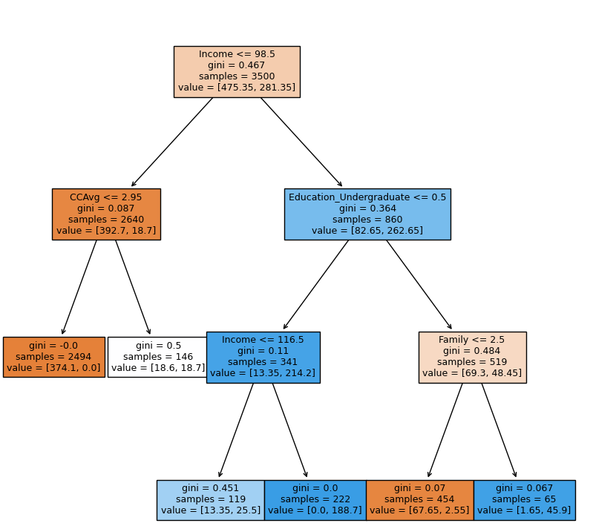
Executive Summary
Income, education, family, and monthly credit card spend are the most important features in predicting personal loan customers.
The marketing campaign should be focused on customers who have higher incomes (over $98.5K) with an undergraduate education and a growing family (1 or 2 children). These customers are dramatically more likely to take a personal loan and thus convert into asset customers.
The best model to use is the Cost-Complexity Model with a ccp_value of .01. It has a .986 recall value on the test set.

Slide 4
Business Problem Overview and Solution Approach
AllLife Bank is looking for a way to predict which liability customers (depositors) they can convert to asset customers (borrowers) by predicting which of them are likely to take out a personal loan with the bank. To do this, we need to understand which customer attributes are most significant in driving predicting whether or not a customer will take a personal loan so that we can target them with a new campaign.
We are going to build 3 supervised learning decision tree algorithms and determine which one is most likely to produce the best results to predict which customers should be targeted in the new campaign.
We are going to consider maximized Recall the best evaluator of the models since we want to minimize False Negatives. A false negative in this context means a customer who was predicted NOT to take a loan would have taken it, leading to a loss of opportunity/profit.

Slide 5
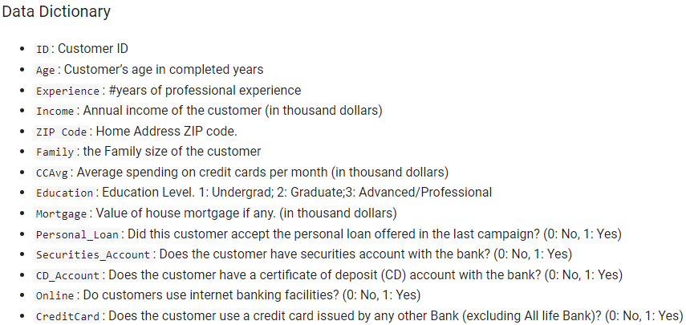
Data Overview – Features and Description

Slide 6
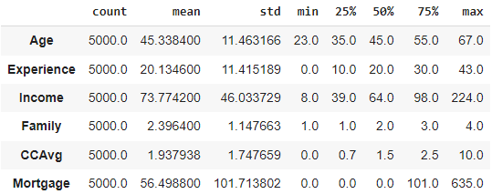
EDA Results - Describe
Customers at the bank are 23 – 67 years old, with a mean and median around 45, meaning it’s somewhat normally distributed.
Income is from $8,000 to $224,000, with a mean of 73,774 and a median of $64,000
Average spending (CCAvg) ranges from 0 to $10,000 per month.
It appears that a significant amount of customers who have a bank account with AllLife Bank do not have their mortgages through the bank. We will keep an eye out to see how much this impacts our predictions.
Age and Experience columns have similar standard deviations and similar increments in the interquartile range. Would dropping one be beneficial since it essentially captures the same information twice?

Slide 7
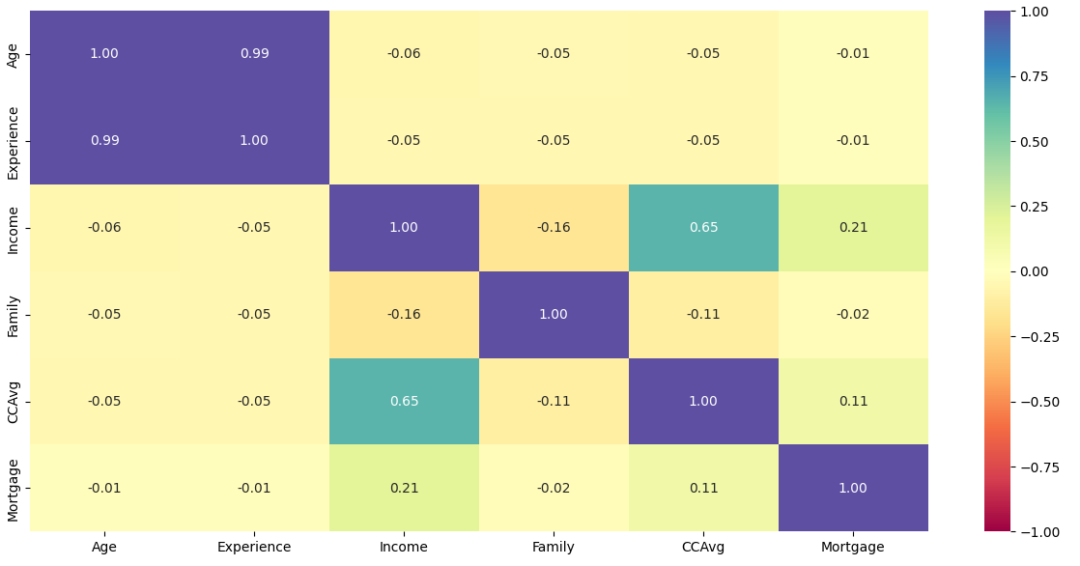
EDA Results - Correlation
Experience and age are highly correlated. We might consider that we are simply counting the same feature twice or not (i.e. can we drop one and still capture the same data without including noise).
Income is highly correlated with average monthly credit card spending, mortgage, and negatively correlated with family size.

Slide 8
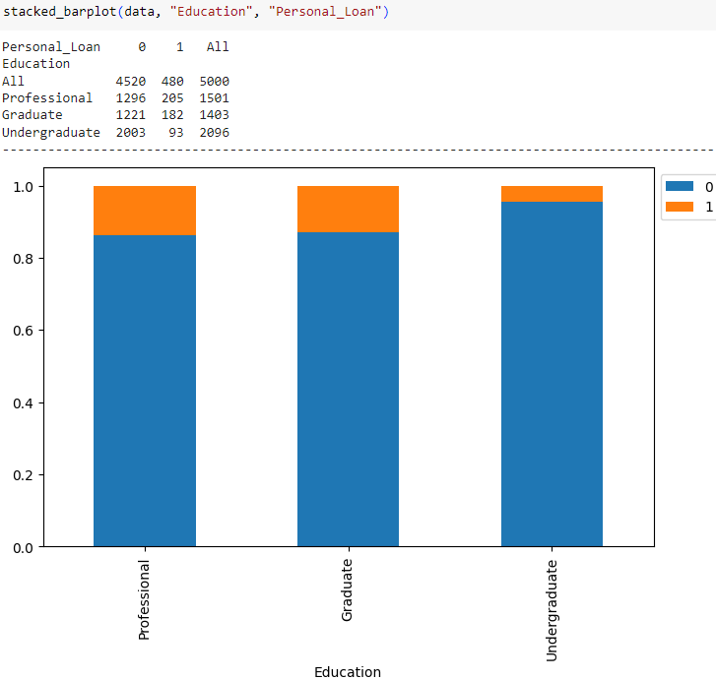
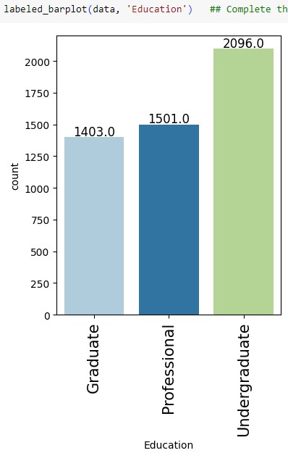
EDA Results - Education
There appears to be a large difference between undergraduate customers and Graduate/Professional customers and their propensity to take out a personal loan. We will keep an eye on how significant this is when we examine the feature importance of our decision tree models.
Customers with an undergraduate degree are overrepresented in our data, so this might have a significant impact.

Slide 9
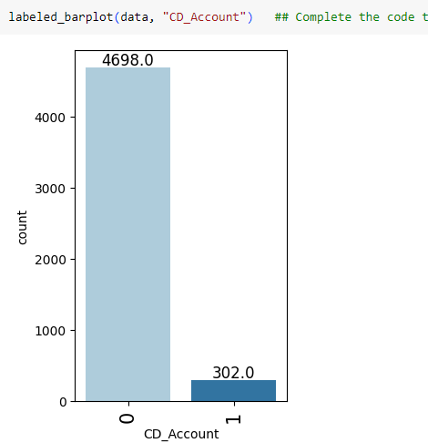
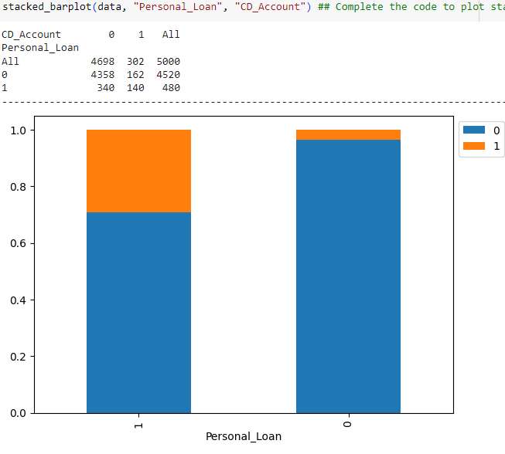
EDA Results – CD Accounts
There seems to be a significantly higher proportion of personal loan borrowers that also have CD Accounts with the bank. However, it appears that a very small percentage of customers at the bank own CD accounts.
We will examine the feature importance in our models.

Slide 10
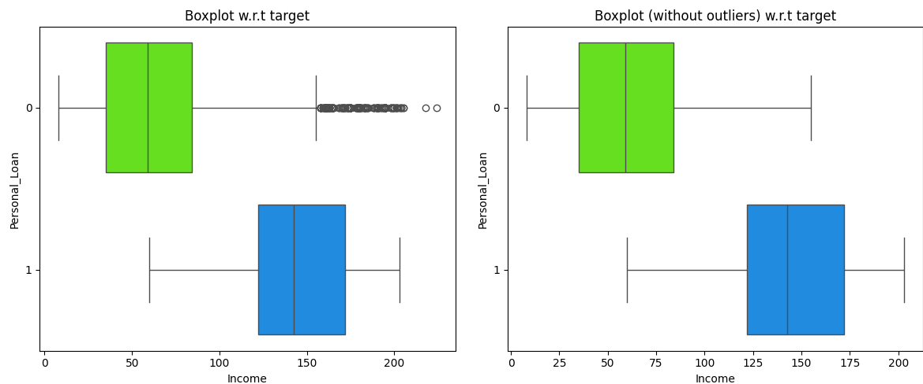
EDA Results – Income
Higher income individuals seem to, on average, take more personal loans.
There are quite a few outliers in income that do not take personal loans, despite having a higher than average income. These customers might possibly just be averse to borrowing.
One more variable we will look at when considering the feature importance of our models.

Slide 11
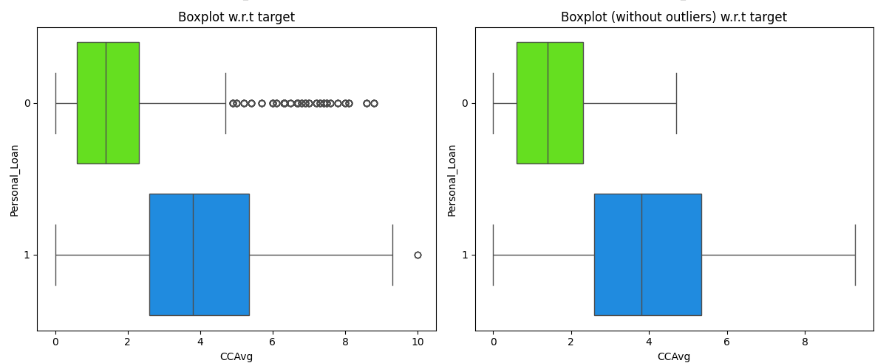
EDA Results – CCAvg
Those with higher average spending on credit cards are more likely to take personal loans
There are quite a few outliers in income that do not take personal loans, despite having a higher than average monthly credit card spending.
We will consider this in feature importance of our models.

Slide 12
Data Preprocessing – Duplicate and Missing Values
There were no found duplicate values. Every ID had a unique transaction row.
No missing values in the dataset, but there were some values in the experience column that were negative. Instead of deleting these rows, we will assume they were data entry error and convert to absolute values to align with the rest of the data set.

Slide 13
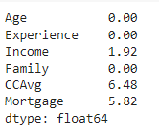
Data Preprocessing – Outlier Check & Feature Eng.
These values represent the % of rows in the data set that contain outliers (defined as outside 1.5*IQR). Nothing major in any category. Highest % of outliers are in credit card average spend and if they have a mortgage, but the outliers are not too egregious to treat.
Feature engineering choices – truncate zipcode to first two values. Change Education, Personal_Loan, Securities_Account, CD_Account, Online, CreditCard, And Zipcode from int64 variables into categories for our modeling purposes.

Slide 14
Data Preprocessing – Data Preparation for Modeling
To prepare data for modeling, we need to separate the independent variables (Mortgage, CCAvg, Family, Income, Age) from the dependent variable that we are looking to predict (Personal_Loan)
We made a subjective decision to drop “Experience” from the data set, since Age is so highly correlated to it that we do not need to count the influence on our dataset twice.
We create dummy variables for ZipCode And Education, resulting in the creation of additional rows of Boolean variables.
We create a train/test split of 70% train/30% test for our first model. The first model will grow until each of the terminal nodes is pure, meaning contains 100% of each condition. It is understood that this will inevitably overfit the data.

Slide 15
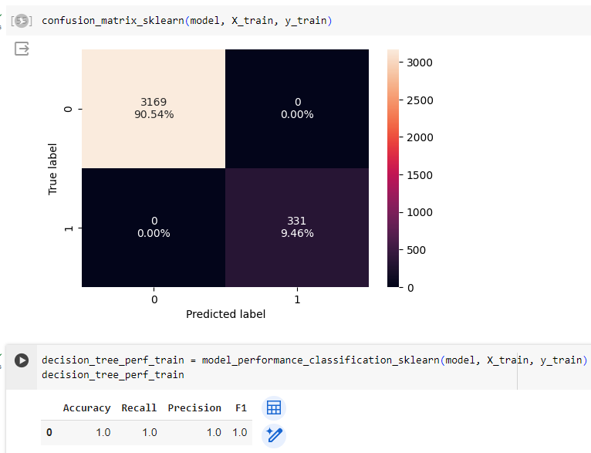
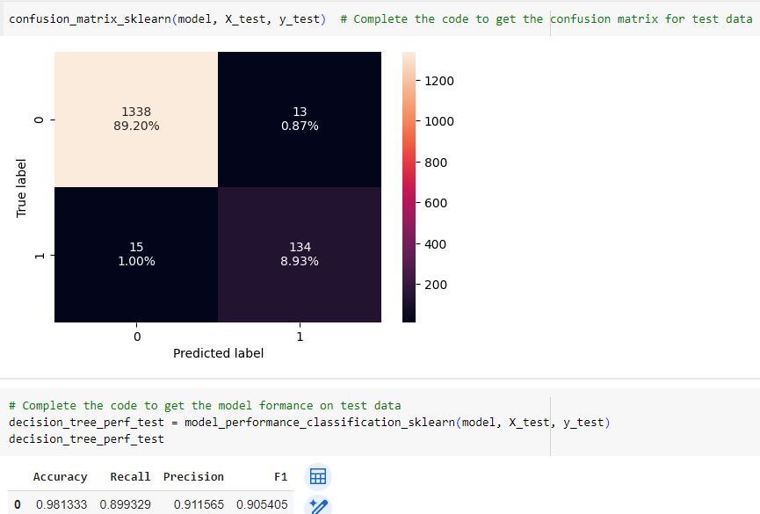
Model Building – Decision Tree – Train v. Test Data
In the initial decision tree model where the decision nodes continue until the all nodes are pure, the performance is perfect for the training data, however, that makes sense due to the overfitting of the data. Plotting performance data of the test data shows how accurately it fits. Recall is dropped by .11. Decent model, but can we improve it?

Slide 16
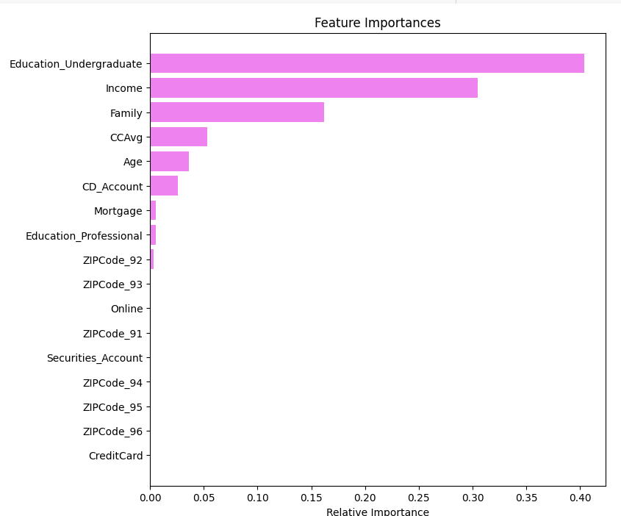
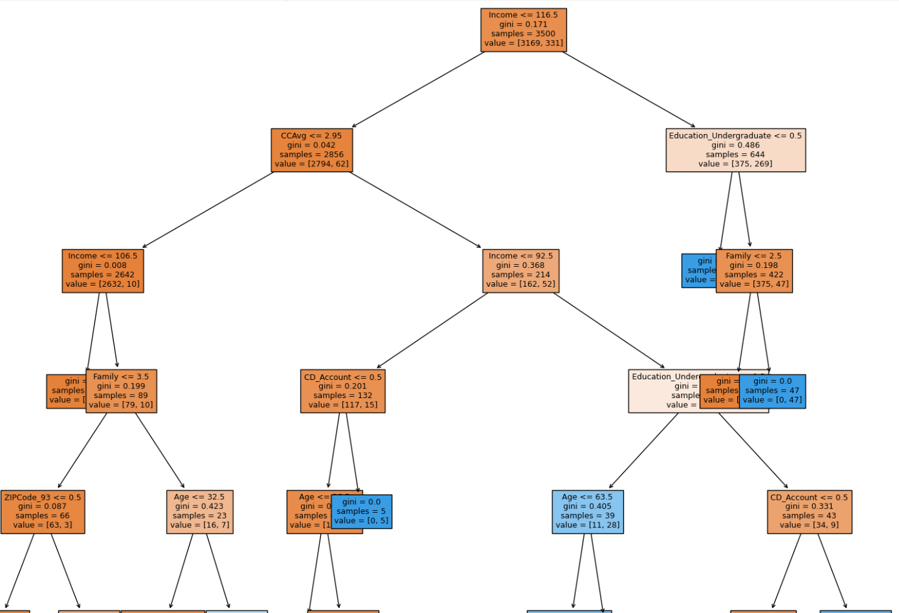
Model Building – Decision Tree – Feature Importance & Decision rules
In this model, having an undergraduate degree, your income, number of members in your family, your average monthly credit card spend, and having a CD account were the most important features.
Only the top nodes are shown on the decision tree as it is very large.

Slide 17
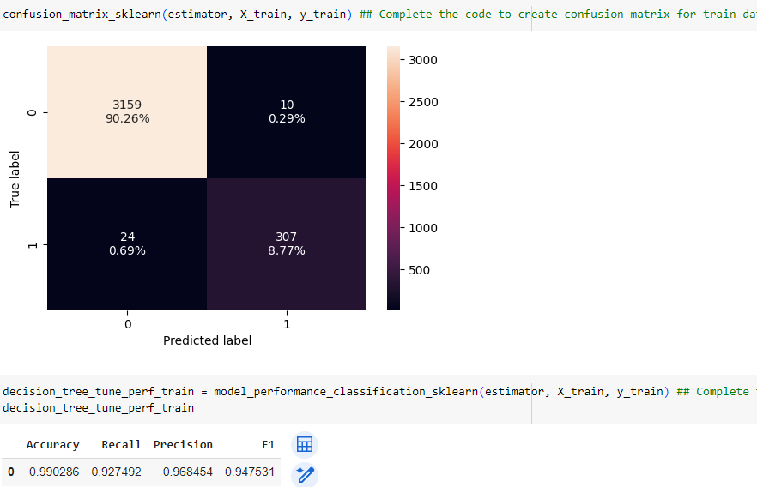
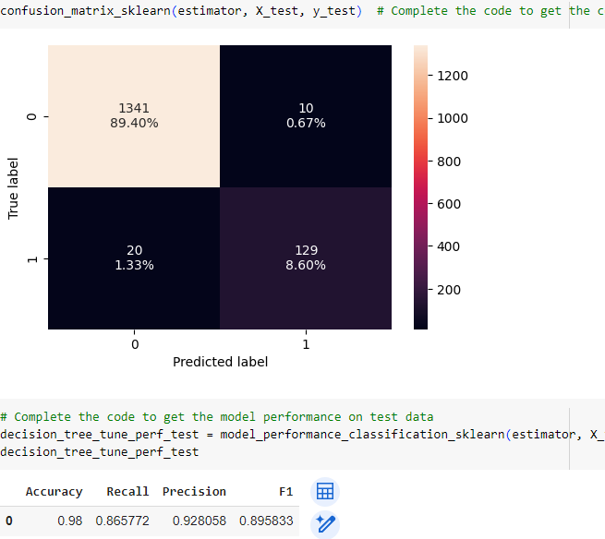
Model Building – Decision Tree – Pre-Pruning with Hyperparameters
This time, we attempt to improve our model by pre-pruning the decision tree using hyperparameters. These are limitations in the Python code that are placed on requirements necessary to generate a subsequent node. If these requirements are not met, a new node is stopped. By doing this, we will be limiting the growth of the tree as it is currently being generated.
Training data for the model (left) is very close to test data (right). Accuracy, precision, and F1 values of the test data are very similar to the trained data, however, there was a significant delta created for the Recall value, which we identified as the most important to model success for our situation. If we are inaccurate in this area, we will produce more false negatives than we want. Meaning we will miss opportunities to offer loans to people who would have taken them if offered, by assuming that they would not have.

Slide 18
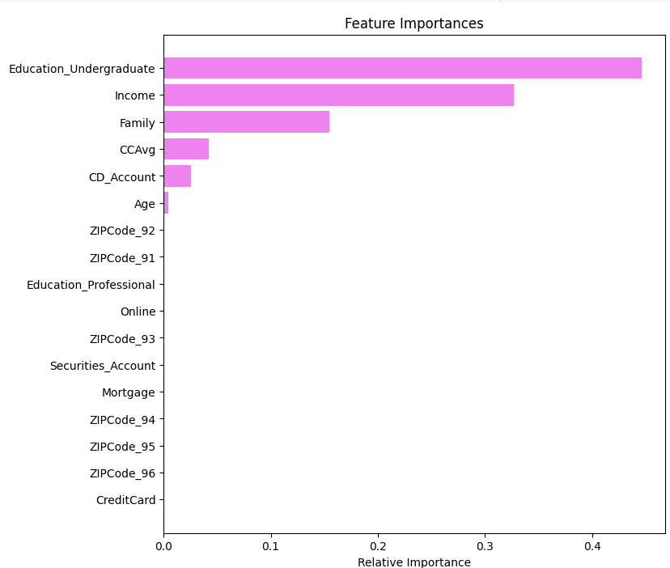
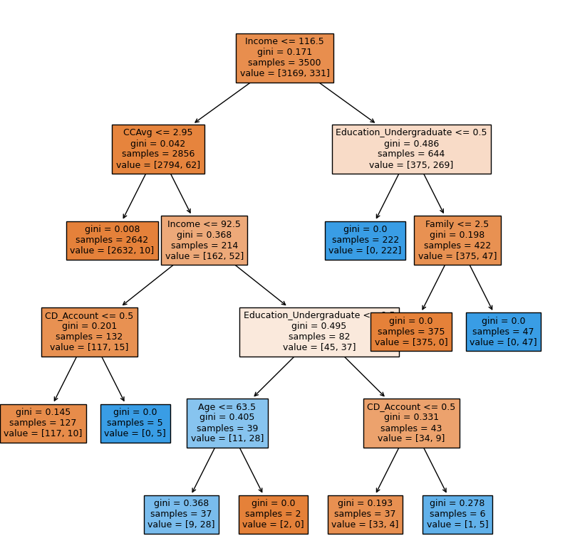
Model Building – Pre-Pruning – Feature Importance
In this model, having an undergraduate degree, your income, the number of members in your family, your average monthly credit card spend, and having a CD account were the most important features, but slightly more muted than the initial decision tree model.
The decision tree is much simpler.

Slide 19
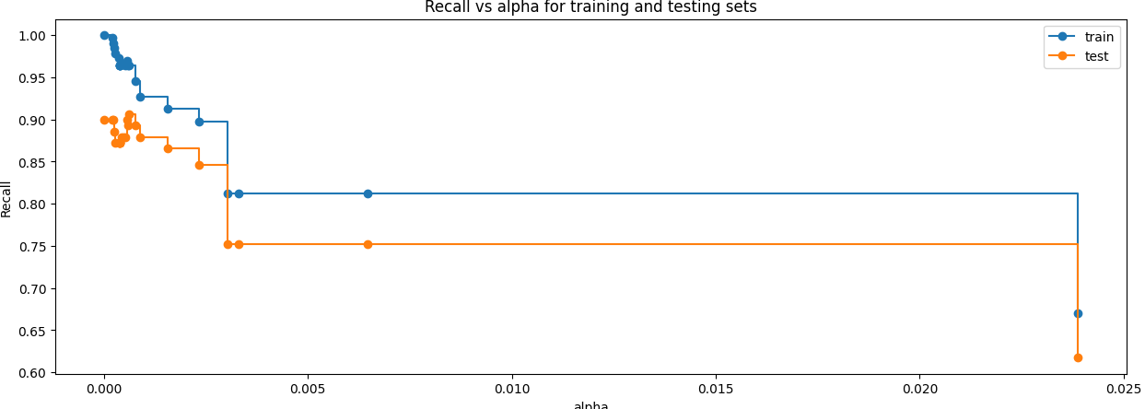
Model Building – Cost Complexity Tuning
In this model, we are going to prune the decision tree after it has already been created, which is known as Post-Pruning. The recall for training and test set are best between .006 and ~.024. We will choose our alpha to be .01.

Slide 20
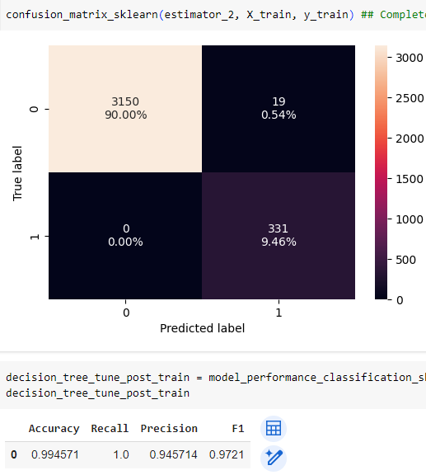
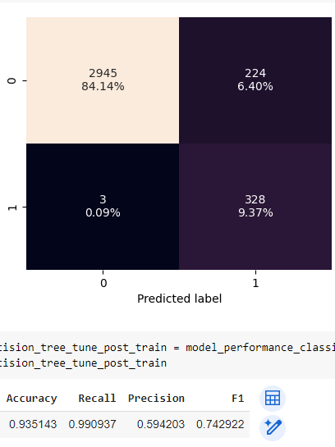
Model Building – Cost Complexity Tuning
Using alpha = .01 yields the following results. Recall of test set is .990, which is very good performance. This should be the recommended model to use for our purposes.

Slide 21
Model Building – Cost Complexity Tuning
Using alpha = .01 yields the following results. Recall of test set is .990, which is very good performance. The decision tree is much simpler looking as well.

Slide 22
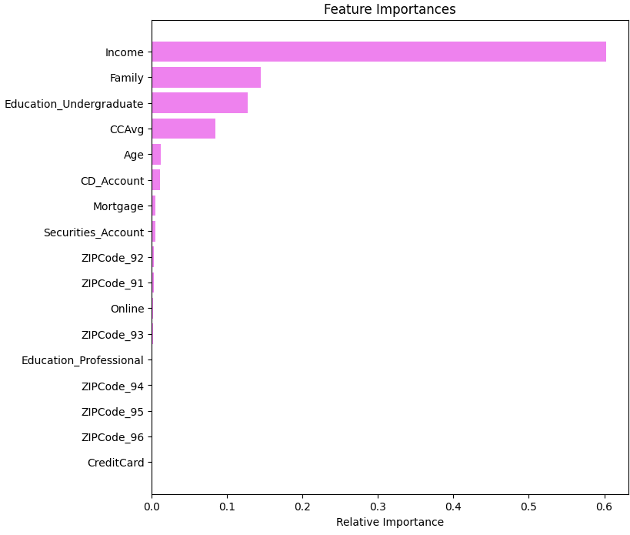
Model Building – Cost Complexity Tuning – Feature Importance
In the Post-Pruning Model, it seems that income has overtaken the top spot for feature importance, followed by family. Undergraduate education is less important compared to the decision tree and pre-pruning model. CCAvg is still important.

Slide 23
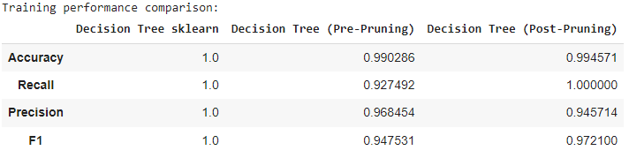
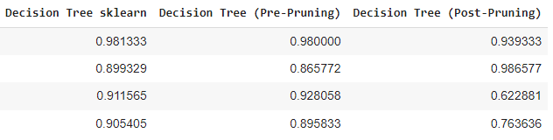
Model Performance Summary
We are evaluating our decision tree models with a preference for the model with the highest Recall value, to minimize false negatives.
We have a decision tree model that grows until all leaves are pure, one that is pre-pruned using hyperparameters, and one that is post-pruned using cost-complexity and finding the idea ccp_alpahs value.
In all 3 decision trees, Income, family, Undergraduate education, and monthly spending on credit card were the most important features. In the cost complexity post-pruned tree, the importance of undergraduate education was reduced.
Comparing models with the training performance on the left and test performance on the right. It appears that the cost-complexity post-pruning model had the highest recall ability on the test set (.986), so this would be the tree that we recommend for AllBank.

Slide 24
APPENDIX

